Slide 1
Smart Greenhouse
Architecture and security of a connected greenhouse system
Presented by: Haithem Tarhouni
2-TIC

Slide 2
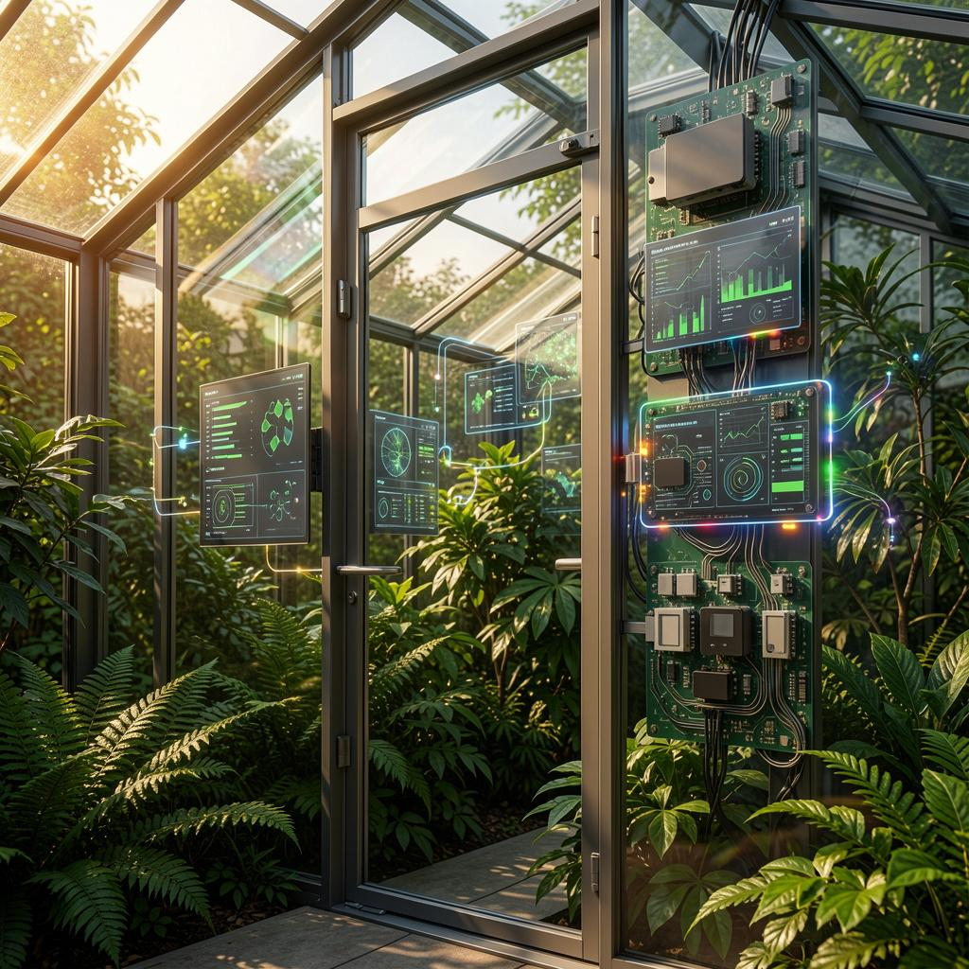
Introduction
A smart greenhouse is an automated system
that uses sensors and a microcontroller
to control temperature, light, and watering
without human intervention.

Slide 3
Problem Statement
Why a Smart Greenhouse?
🌱 Traditional farming challenges:
• Manual monitoring is time-consuming
• Human error leads to crop loss
• Late response to environmental changes
• Water and energy waste
💡 Solution: Automated greenhouse with IoT

Slide 4
Objectives
Project Goals:
✅ Automate watering based on soil moisture
✅ Automate lighting based on ambient light
✅ Control temperature with cooling fan
✅ Secure access with PIN keypad
✅ Send alerts to owner's phone
✅ Display real-time data

Slide 5
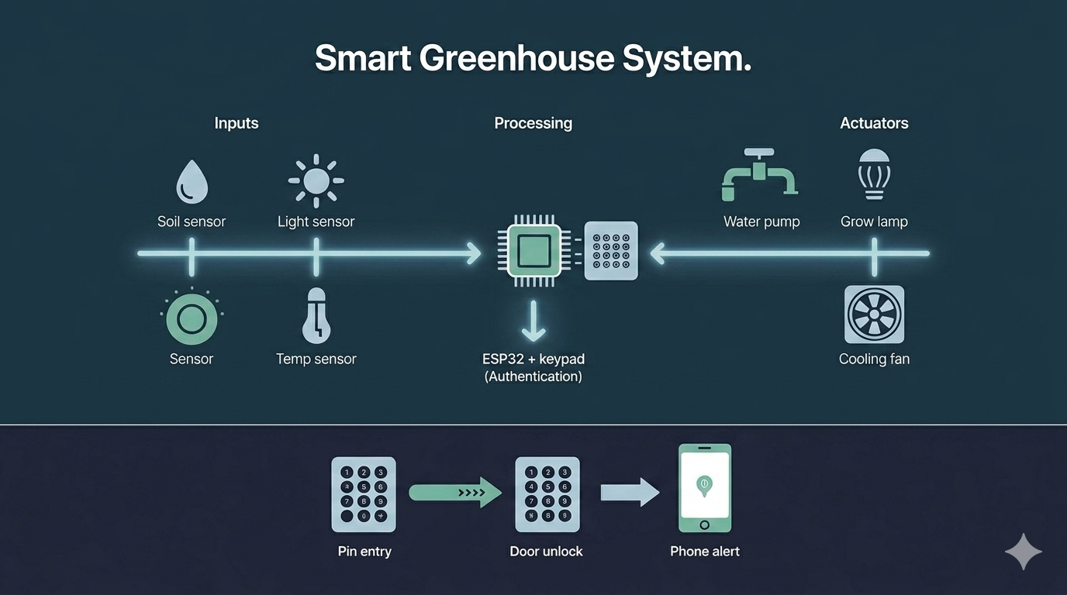

Slide 6
System Overview
The system operates in three simple steps. First, the user inputs the required data through an easy-to-use interface. Second, the system processes that information using a built-in logic engine, which analyzes the data and applies predefined rules or algorithms. Finally, the system generates the appropriate output—such as a result, recommendation, or action—and displays it on the screen. This entire process happens in real time, ensuring fast and accurate responses.

Slide 7
Components Used
Component | Purpose
ESP32 | Main controller (brain)
Keypad | PIN entry for door access
Soil moisture sensor | Detects dry/wet soil
Light sensor (LDR) | Detects dark/bright
DHT22 sensor | Temperature & humidity
LCD display | Display sensor data
LEDs (3x) | Simulate pump, light, fan
Buzzer | Alarm on 3 failed attempts

Slide 8


Slide 9
Security Threats
Why security matters:
1. DATA INTEGRITY: Hackers can modify sensor readings (temperature, humidity, soil moisture)
→ System believes false data which leads to wrong actions
2. OPERATIONAL SABOTAGE: Hackers can send malicious commands
→ Water pumps turn OFF, heaters turn OFF, alarms disabled
3. FINANCIAL LOSS: - Destroyed crops = lost revenue
- Stolen data = loss of competitive advantage
4. PHYSICAL DAMAGE: Overheating, flooding, or electrical damage to equipment
❗️ Security is not optional. It is essential for safe operation. ❗️

Slide 10
Security Measures
How to protect a smart greenhouse:
1. DEVICE SECURITY
→ Use strong, unique passwords for all devices
→ Enable secure boot and flash encryption
2. NETWORK SECURITY
→ Use WPA2/WPA3 WiFi encryption
→ Firewall to block unauthorized access
3. AUTHENTICATION
→ Multi-factor authentication for remote access
→ PIN or biometric for physical door access
4. DATA SECURITY
→ Encrypt data at rest
→ Regular backups

Slide 11
Challenges
1. Limited processing power
→ ESP32 has less memory than a computer
2. Low power constraints
→ Security features must be energy efficient
3. Physical access
→ Attacker can touch the device
4. Long lifetime
→ Devices may run for years without updates
5. Cost limitations
→ Cannot add expensive security hardware

Slide 12
Solutions
1. Use lightweight security protocols (CoAP instead of HTTPS). Offload heavy tasks to cloud.
2. Use hardware-accelerated encryption (ESP32 has built-in AES). Wake up only when needed.
3. Use tamper-resistant enclosures. Secure boot prevents unauthorized firmware.
4. Over-the-air (OTA) updates. Modular design to replace individual components.
5. Use open-source security libraries. Built-in ESP32 security (Flash Encryption).

Slide 13
Conclusion
This presentation covered the design, architecture, and security of a smart greenhouse IoT system. It explained why automation is needed in agriculture, how sensors and actuators work together, and what security risks exist in connected environments. The main focus was on security, including authentication, brute force protection, and fail-safe design. A working simulation was demonstrated, along with practical security measures that can be applied to real greenhouses. The project shows that with proper planning, a smart greenhouse can be both efficient and secure.

Slide 14


